Slide 1
Pitfalls Of Database Design

Slide 2
Creating an effective design for a relational database is a key element in building a reliable system.
There is no one "correct" relational database design for any particular project, and developers must make choices to create a design that will work efficiently.
There are a few common design pitfalls that can harm a database system.

Slide 3
Careless Naming Practices
Choosing names is an aspect of database design that is often neglected but can have a considerable impact on usability and future development.
To avoid this, both table and column names should be chosen to be meaningful and to conform to the established conventions, ensuring that consistency is maintained throughout a system.
A number of conventions can be used in relational database names, including the following two examples for a record storing a client name: "client_name" and "clientName."

Slide 4
Lack of Documentation
Creating documentation for a relational database can be a vital step in safeguarding future development.
There are different levels of documentation that can be created for databases, and some database management systems are able to generate the documentation automatically.
For projects where formal documentation is not considered necessary, simply including comments within the SQL code can be helpful.

Slide 5
Failure to Normalize
Normalization is a technique for analyzing, and improving on, an initial database design.
A variety of techniques are involved, including identifying features of a database design that may compromise data integrity, for example items of data that are stored in more than one place.
Normalization identifies anomalies in a database design, and can preempt design features that will cause problems when data is queried, inserted or updated.

Slide 6
Lack of Testing
Failure to test a database design with a sample of real, or realistic, data can cause serious problems in a database system.
Generally, relational database design is started from an abstract level, using modeling techniques to arrive at a design.
The drawback to this process is that the design sometimes will not relate accurately to the actual data, which is why testing is so important.

Slide 7
Failure to Exploit SQL Facilities
SQL has many capabilities that can improve the usability and success of a database system.
Facilities such as stored procedures and integrity checks are often not used in cases where they could greatly enhance the stability of a system.
Developers often choose not to carry out these processes during the design stages of a project as they are not a necessity, but they can help to avoid problems at a later stage.

Slide 8
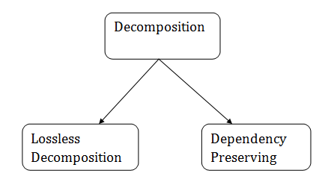
Relational Decomposition
When a relation in the relational model is not in appropriate normal form then the decomposition of a relation is required.
In a database, it breaks the table into multiple tables.
If the relation has no proper decomposition, then it may lead to problems like loss of information.
Decomposition is used to eliminate some of the problems of bad design like anomalies, inconsistencies, and redundancy.

Slide 9
Lossless Join Decomposition
Lossless-join decomposition is a process in which a relation is decomposed into two or more relations.
This property guarantees that the extra or less tuple generation problem does not occur and no information is lost from the original relation during the decomposition. It is also known as non-additive join decomposition.
When the sub relations combine again then the new relation must be the same as the original relation was before decomposition.

Slide 10
Consider a relation R if we decomposed it into sub-parts relation R1 and relation R2.
The decomposition is lossless when it satisfies the following statement −
If we union the sub Relation R1 and R2 then it must contain all the attributes that are available in the original relation R before decomposition.
Intersections of R1 and R2 cannot be Null. The sub relation must contain a common attribute. The common attribute must contain unique data.

Slide 11
The common attribute must be a super key of sub relations either R1 or R2.
Here,
R = (A, B, C)
R1 = (A, B)
R2 = (B, C)
The relation R has three attributes A, B, and C. The relation R is decomposed into two relation R1 and R2. . R1 and R2 both have 2-2 attributes. The common attributes are B.
The Value in Column B must be unique. if it contains a duplicate value then the Lossless-join decomposition is not possible.

Slide 12
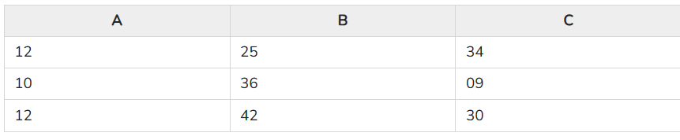
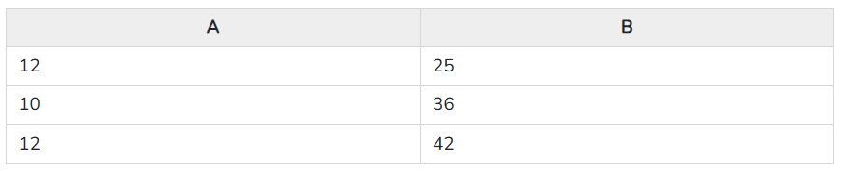
Draw a table of Relation R with Raw Data −
R (A, B, C)
It decomposes into the two sub relations −
R1 (A, B)

Slide 13
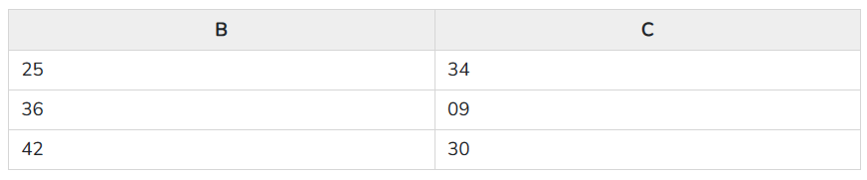
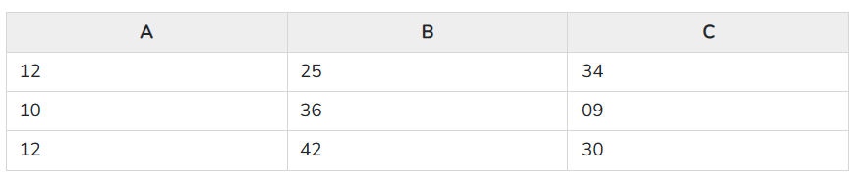
R2 (B, C)
Now, we can check the first condition for Lossless-join decomposition.
The union of sub relation R1 and R2 is the same as relation R.
R₁U R₂ = R
We get the following result −
The relation is the same as the original relation R. Hence, the above decomposition is Lossless-join decomposition.

Slide 14
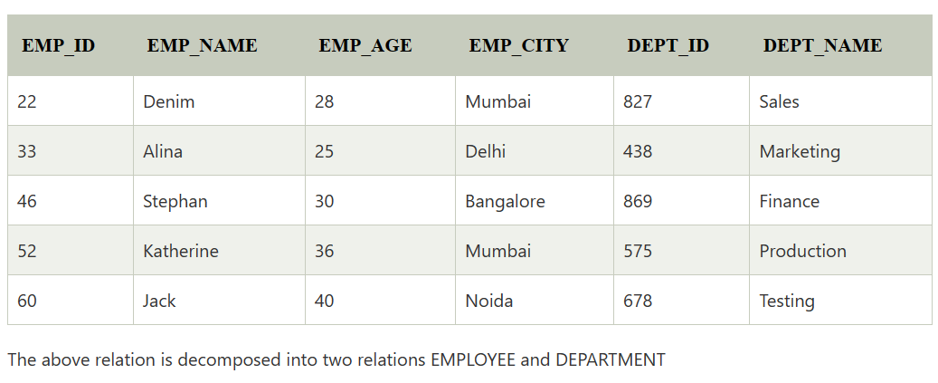
Example:
EMPLOYEE_DEPARTMENT table:

Slide 15
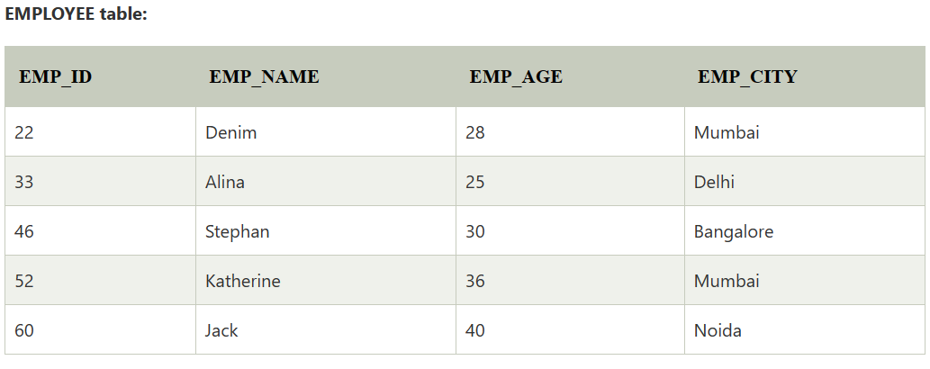
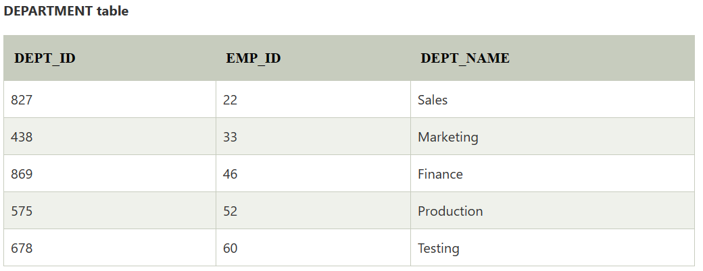

Slide 16
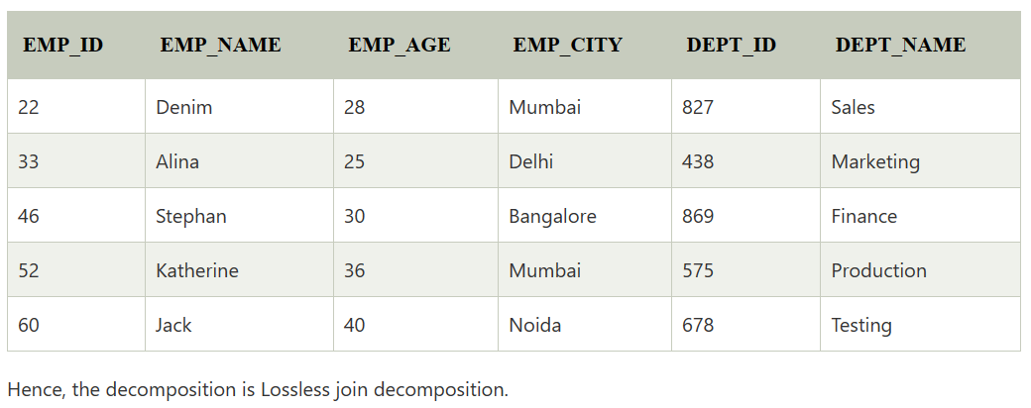
Now, when these two relations are joined on the common column "EMP_ID", then the resultant relation will look like:
Employee ⋈ Department

